Slide 1
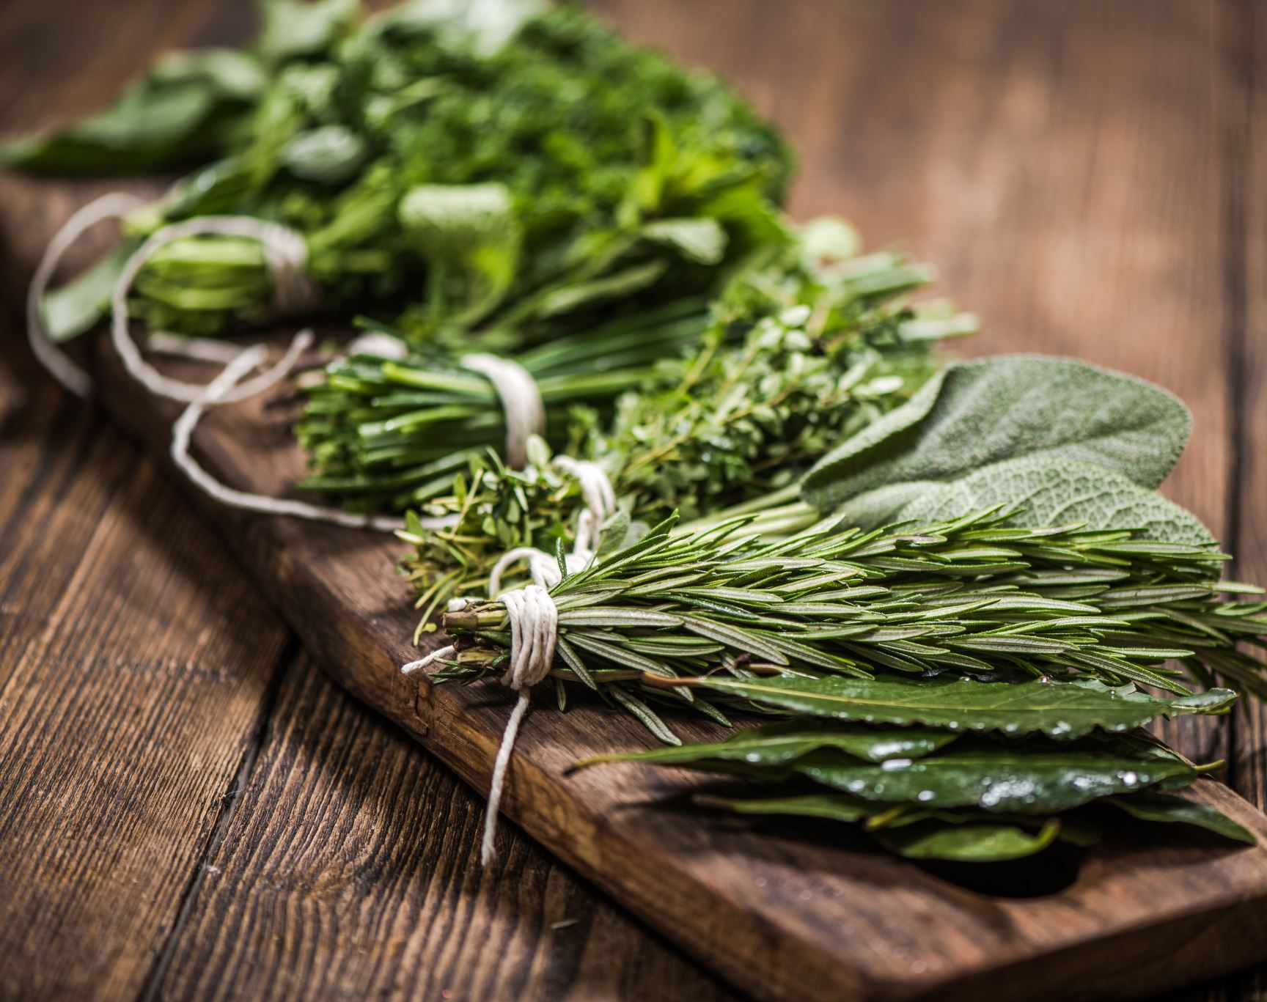

UX/UI Design For Food Donation: A Sustainable System For Charity And Waste Reduction
Department of Industrial Design
National Institute of Technology Rourkela
Presented by
SONALI SAHOO (117ID0497)
T PRITHVI KIRAN (117ID0488)
Guided by
Dr MOHAMMED RAJIK KHAN

Slide 2
MOTIVATION
METHODOLOGY
Use technology to help people contribute more towards social welfare.
The pandemic has shown us that voluntary help is invaluable and contactless payments are even more important.
Huge amounts of edible food is wasted in functions, restaurants, hostel mess
Most people want to donate but are too lazy or don’t have an easy medium to donate.
Through this app, we aim to remove the barriers to donation.
Ideation
General CSCW practices
Donation Behavior and Food waste
Comparative Analysis
User Experience Flow
Interactive User Interface
Development of Application
Brainstorming
Features, functions and user process flow
Wireframe sketches
Formative Research
Concept Generation
OBJECTIVE
To enhance the user experience of managing the surplus/waste food through donation and distribution to the needy.
To design an interactive user interface and further develop it into a food management application.

Slide 3
LITERATURE REVIEW
The paper "Food donation portal“ [1], which was published in 2015, presents an idea of linking donors with NGOs.​
'Helping Hands‘ [2], an internet-based program provides donors and seekers with a forum to donate and collect old stuff and leftovers.​
The paper "Food donations using a forecasting-simulation model' [3], published in 2016, presents a methodology to estimate donations for non-profit hunger relief organizations.​
Published in 2014, the paper 'Smartphone-Based Waste Food Supply Chain for Aurangabad City Using GIS Location-Based and Google Web Services'[4] explains the GIS client-server and the hunger-free city smartphone application.​
'Share my Dabba' is an effort to bring surplus food in dabbas to hungry children on the street using a tiny sticker and a massive outreach of dabbawala network [5].​
Food4U application [6] : It has a map GPS based positioning system where users can access the details of each users by clicking at each GPS position.
The patent filed for food donation systems [7] and methods incorporates the user options like ONE TIME GIVE and Periodic GIVE preferences or activation choices.

Slide 4
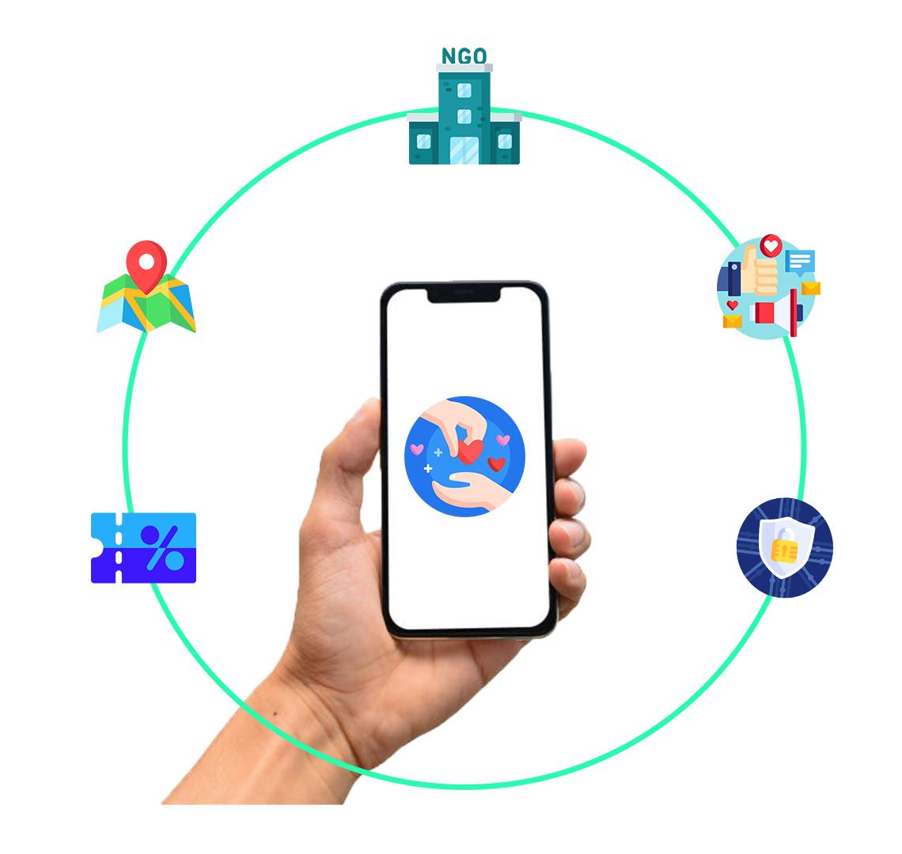
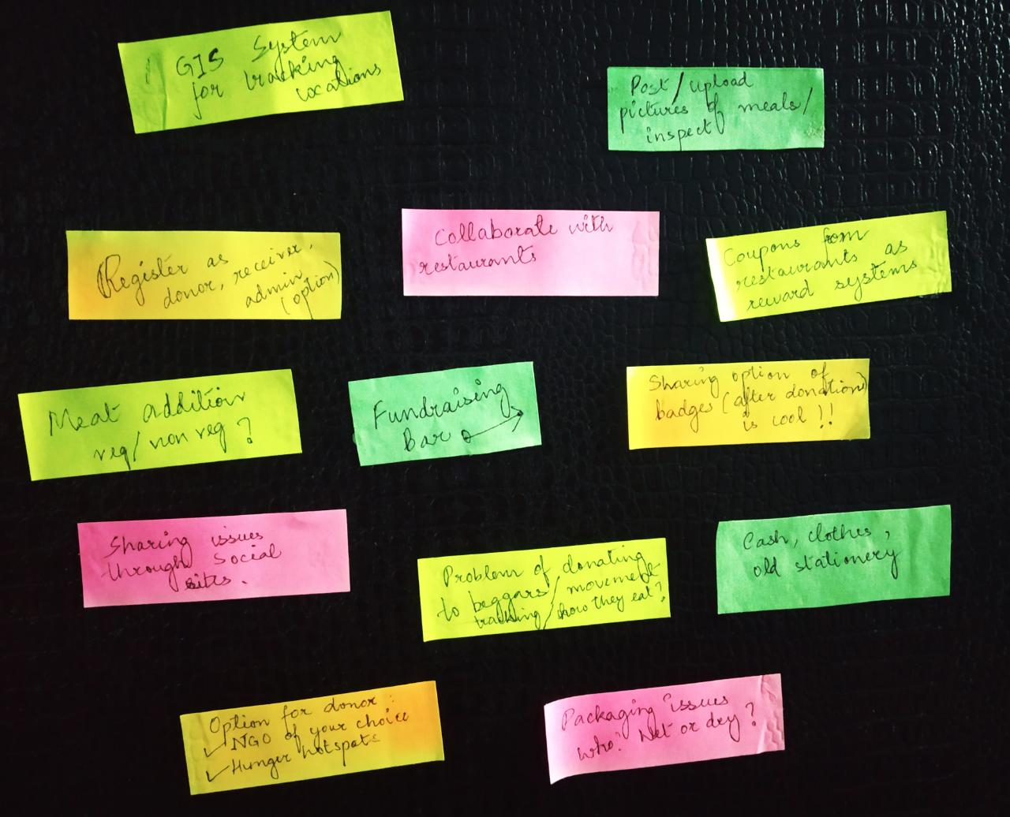

IDEATION
Collaborate with charitable organisations
1
The location of the donors,
donated food and the receiver can be tracked.
Brainstorming
Possible Features
2
Sharing of campaigns and active engagement with local issues
5
3
Rewards and coupons to be provided for donation and limiting waste
4
Donation using a secure network and authenticated systems
Fig 1: Brainstorming Ideas

Slide 5
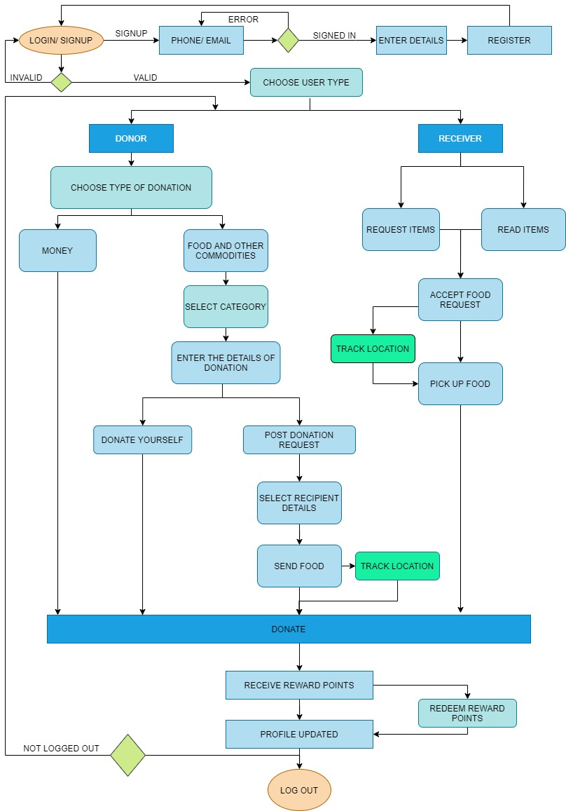
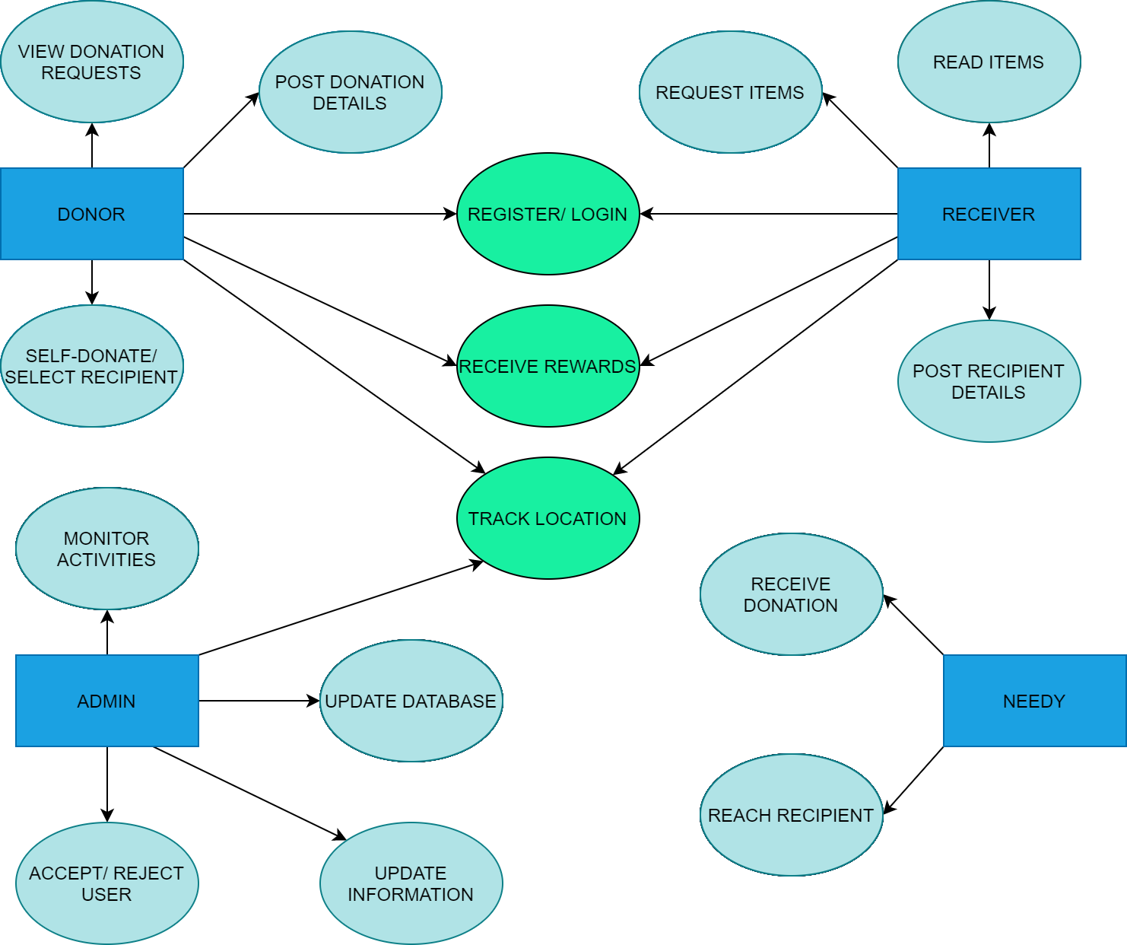
IDEATION
User Function
User Process Flow
Fig 2: User Function Diagram
Fig 3: User Process Flow Diagram

Slide 6
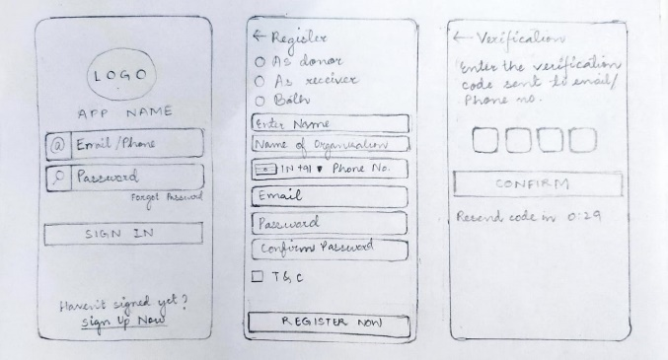
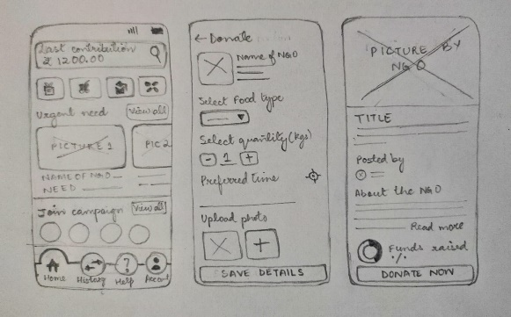
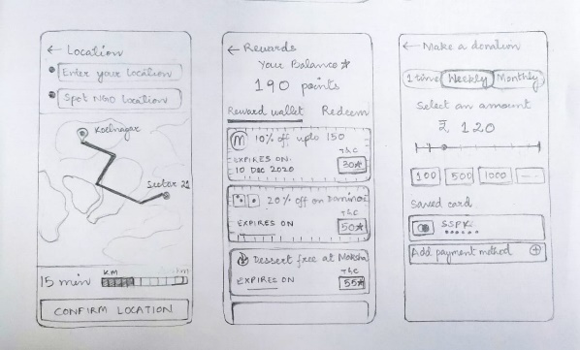
IDEATION
Wireframing
Fig 4: Wireframe Sketches
i. Sign up screen, ii- register details, iii-OTP authentication
iv- main screen, v- donation details,
vi- NGO details
vii- main screen, viii- rewards & coupons page , ix- money donation options
Figure 4-6: The low fidelity wireframes are sketched and various screens are shown

Slide 7
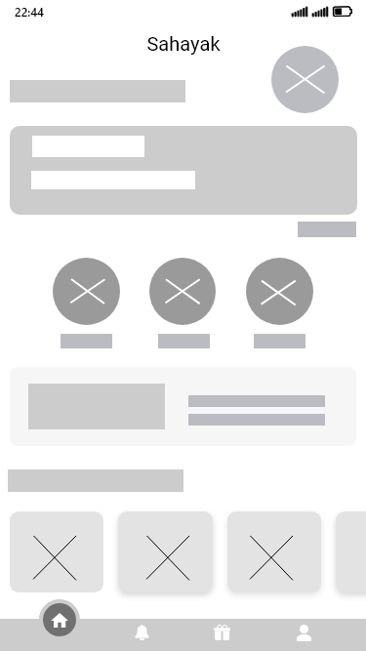
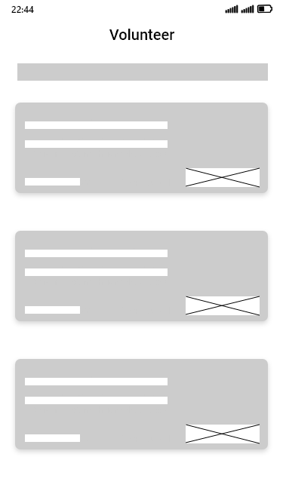
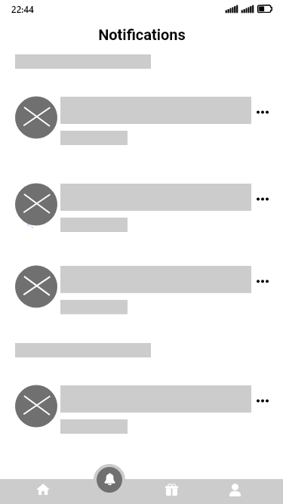
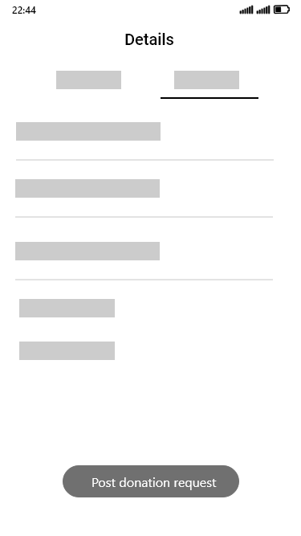
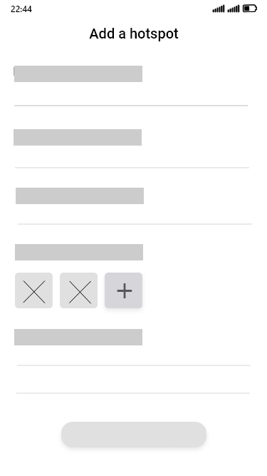
Main screen
Volunteering screen
Notifications screen
Entering details of surplus food- Advanced
Adding a hunger hotspot
Figure 7-11: The low fidelity wireframes ( designed using Adobe XD)

Slide 8
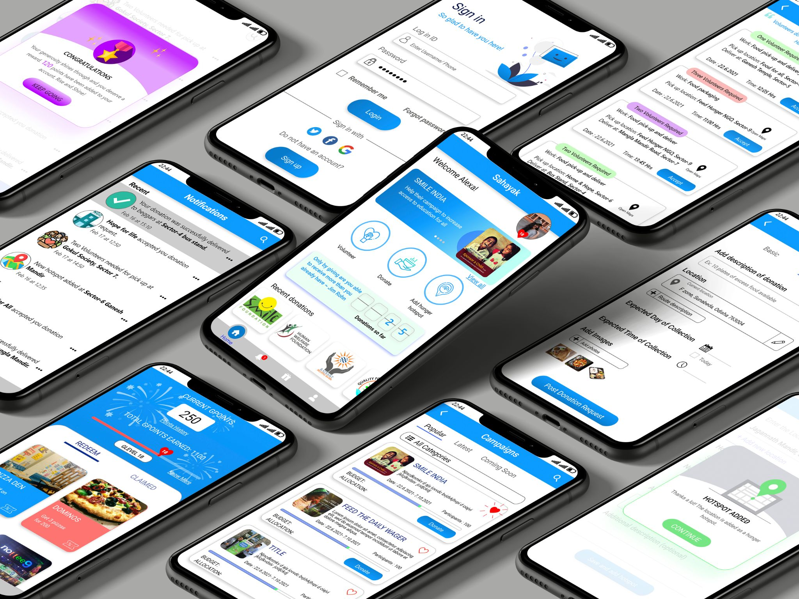
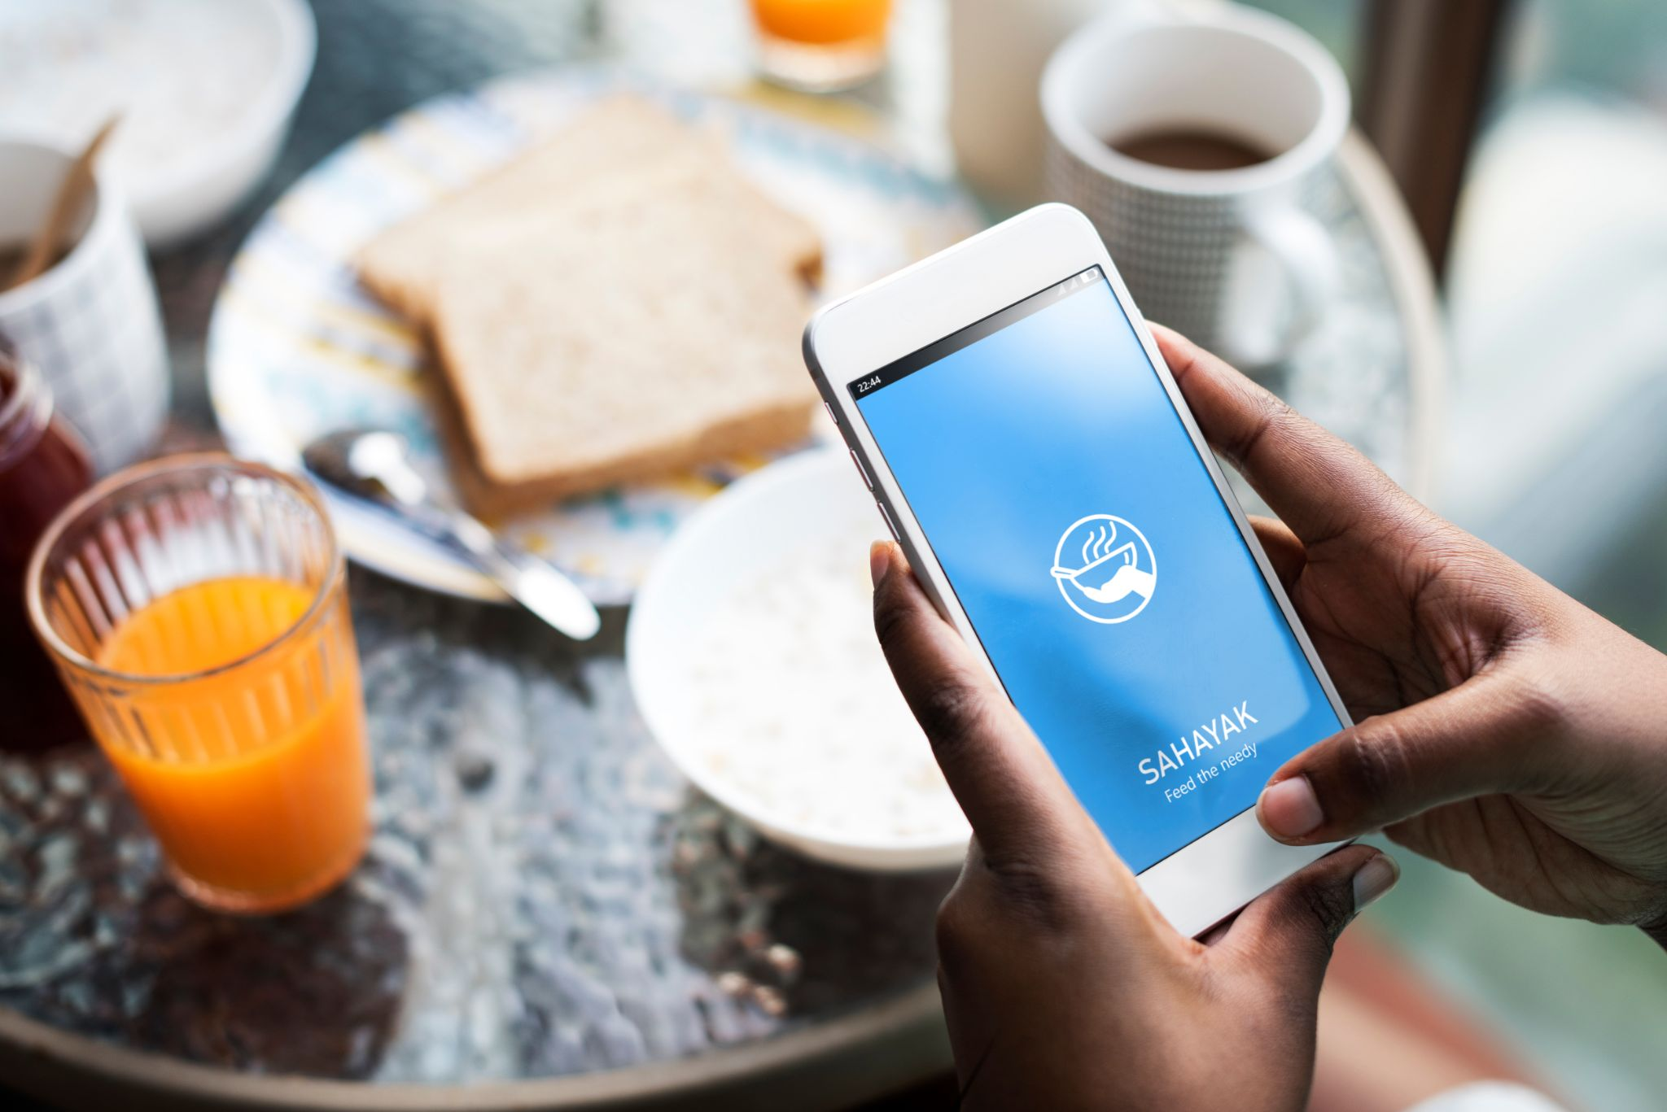
MOCK-UP
Fig 12,13: Design Mock ups for the application

Slide 9

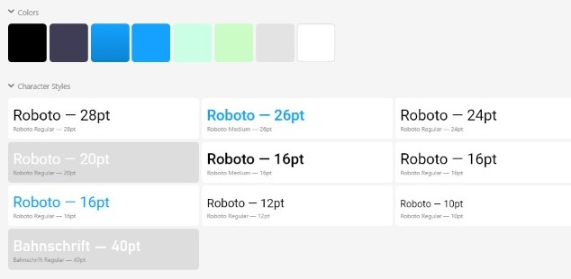
DESIGN ASPECTS
Cool colors can create a calming effect, inspiring logical thought and bring memories of kindness, joy and love.
Blue is considered a color of stability and tends to be perceived in association with authority, trust and dependability
Bright hues can motivate donors to take action.
Roboto was used as it is the standard font for user interfaces in Android, hence gives good readability across devices.
The round shape in logo denotes wholesomeness, the name is kept colloquial for better relatability among general masses
Figure 14,15: Logo, colour and typography. Dominant app colour used: Dodger Blue
[ Reference source: https://smallbusiness.chron.com/importance-colors-fundraising-advertising-70854.html ]

Slide 10
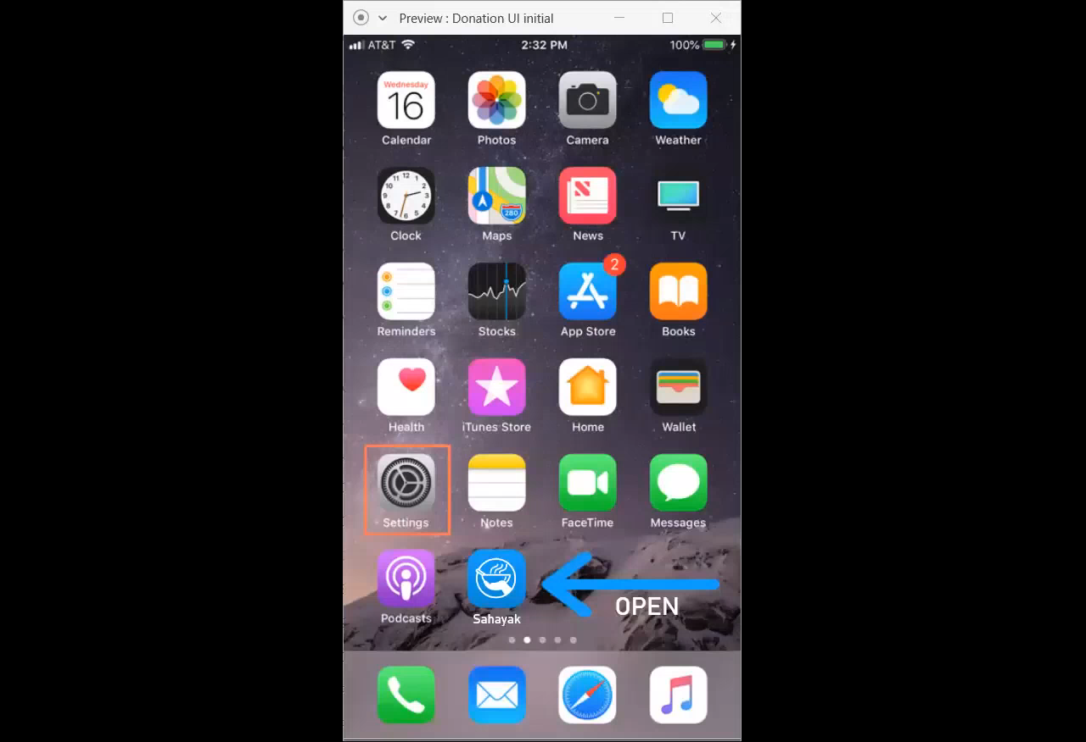
FUTURE PERSPECTIVE
WORKING OF THE APPLICATION
The navigation through the app is shown in the attached video.
For better understanding, it will be played from the computer.
Development of the digital software application for practical implementation.
Collaboration with different restaurants, hostel messes, as well as with NGOs, charity organizations, social service clubs.
Authenticated and secured system of management at the backend.
Incorporate knowledge, spread awareness and encourage people to donate.
Collect feedback and improve the functioning.
Extend the App for eradicating not just hunger, but other requirements like clothes, medicines etc.

Slide 11
REFERENCES
Naman Talati, Omkar Surve, Jenil Shah, Shrey Kyal. 2017. "Food Donation Portal." Ijsrd - International Journal For Scientific Research & Development 491-493.
Komal Mandal, S. J. (April 2016). Food Wastage Reduction Through Donation Using Modern Technological Approach: Helping Hands. International Journal Of Advanced Research In Computer Engineering & Technology (Ijarcet), 906-908.
I. A. Nuamah, L. Davis, S. Jiang And N. Lane. 2015. "Predicting Donations Using A Forecasting-Simulation Model." Winter Simulation Conference (Wsc) 1880-1891.
Hitesh Raut, Swapnil Rajput, Dhananjay B. Nalawade, Karbhari V. Kale. 2016. "Smartphone-Based Food Supply Chain For Aurangabad City Using Gis Location-Based And Google Web Services." Ijret: International Journal Of Research In Engineering And Technology 301-308.
2013. Share My Dabba. Happylifewelfare.Org/Share-Dabba-Compaign.Html.
Lee, Angela C. Jun 12, 2014. Systems And Methods For Mobile Device Donations To Charitable Organizations. U.S. Patent 20140164275.
Suraya Masrom, Abdullah Sani Abd. Rahman, Farah Norliyana Azahar, Nasiroh Omar. 2018. "Food For You (F4u) Mobile Charity Application." International Journal Of Engineering & Technology 520-523.
THANK YOU

